Slide 1
Am I obligated to keep the Law? Part 2

Slide 2
Last week we asked the question, am I obligated to keep the ten commandments?

Slide 3
37 And he said to him, “You shall love the Lord your God with all your heart and with all your soul and with all your mind. 38 This is the great and first commandment. 39 And a second is like it: You shall love your neighbor as yourself. 40 On these two commandments depend all the Law and the Prophets.”
Matthew 22:37–40
ESV

Slide 4
I am to love God and love people.

Slide 5
Big Idea: I live in the kingdom of God through love and righteousness.

Slide 6
21 “You shall not wrong a sojourner or oppress him, for you were sojourners in the land of Egypt.
Exodus 22:21
ESV

Slide 7
2 You shall not fall in with the many to do evil, nor shall you bear witness in a lawsuit, siding with the many, so as to pervert justice,
Exodus 23:2
ESV

Slide 8
Exodus 22:21 (NIV): "Do not mistreat or oppress a foreigner, for you were foreigners in Egypt."
This verse reflects a moral and social principle emphasizing compassion and fairness, particularly toward those who are vulnerable or marginalized.
Exodus 23:2 (NIV): "Do not follow the crowd in doing wrong. When you give testimony in a lawsuit, do not pervert justice by siding with the crowd."
This verse underscores the moral principle of individual responsibility and the importance of upholding justice, even when it goes against popular opinion.
Exodus 21–23
ESV

Slide 9
Civil Laws:
Exodus 21:2-11: Regulations concerning Hebrew slaves. Exodus 21:12-27: Laws regarding personal injury, including penalties for harming others and guidelines for compensation. Exodus 21:28-36: Laws regarding responsibility for animals causing harm or damage.‌ Exodus 22:1-15: Various laws concerning theft, restitution, and property damage. Exodus 22:16-31: Additional laws regarding various civil matters such as seduction, witchcraft, lending, and kindness to foreigners, widows, and orphans. Exodus 23:1-9: Instructions on administering justice impartially and fairly, without showing favoritism or oppressing the powerless, and warnings against spreading false rumors or perverting justice.

Slide 10
Moral Laws:
Exodus 20:1-17: The Ten Commandments, including prohibitions against idolatry, blasphemy, murder, adultery, theft, false witness, and coveting.

Slide 11
Social Laws:
Exodus 21:2-11:Regulations concerning Hebrew slaves (also overlaps with civil law). Exodus 21:20-21: Guidance on the treatment of slaves, emphasizing protection and consequences for abuse.‌ Exodus 22:21-27: Commands to show kindness and justice to foreigners, widows, and orphans, with warnings against mistreatment.‌ Exodus 23:1-9: Further instructions on justice, fairness, and care for the vulnerable members of society. Exodus 23:10-19: Regulations regarding the Sabbath, Sabbatical year, and various feasts, emphasizing rest, provision, and worship.

Slide 12
Purpose of the Law:
1. It revealed God's character and his standards of righteousness (Deuteronomy 4:8)
2. It functioned as a covenantal agreement between God and Israel, outlining the terms of their relationship (Exodus 19-24).
3. It provided guidance and instruction for living a life pleasing to God (Psalm 119:105).

Slide 13
Limitations of the Law:
1. It could not impart salvation or justification before God (Romans 3:20).
2. It highlighted human sinfulness and inability to fully obey God's commands (Romans 7:7-25).
3. It served as a temporary measure until the coming of the promised Messiah (Galatians 3:19-25).

Slide 14
So what was the purpose of the Law?

Slide 15
The Law was given by God so that Israel could live in a covenant relationship with him and in relationship to each other.
‌Also, God’s good law was given pointing to a time when Messiah would come and establish God’s kingdom.
‌

Slide 16
15 and saying, “The time is fulfilled, and the kingdom of God is at hand; repent and believe in the gospel.”
Mark 1:15
ESV

Slide 17
17 “Do not think that I have come to abolish the Law or the Prophets; I have not come to abolish them but to fulfill them.
Matthew 5:17
ESV

Slide 18
In Jesus, the time of the law is now fulfilled!

Slide 19
Why? Because Messiah is now here.

Slide 20
4 But when the fullness of time had come, God sent forth his Son, born of woman, born under the law, 5 to redeem those who were under the law, so that we might receive adoption as sons.
Galatians 4:4–5
ESV

Slide 21
23 Now before faith came, we were held captive under the law, imprisoned until the coming faith would be revealed. 24 So then, the law was our guardian until Christ came, in order that we might be justified by faith. 25 But now that faith has come, we are no longer under a guardian, 26 for in Christ Jesus you are all sons of God, through faith. 27 For as many of you as were baptized into Christ have put on Christ. 28 There is neither Jew nor Greek, there is neither slave nor free, there is no male and female, for you are all one in Christ Jesus. 29 And if you are Christ’s, then you are Abraham’s offspring, heirs according to promise.
Galatians 3:23–29
ESV

Slide 22
The Greek word translated as "tutor" in this verse is "παιδαγωγός" (paidagōgos), which referred to a slave who was responsible for taking care of a child or a young person in Greco-Roman society and to make sure he behaves correctly.

Slide 23
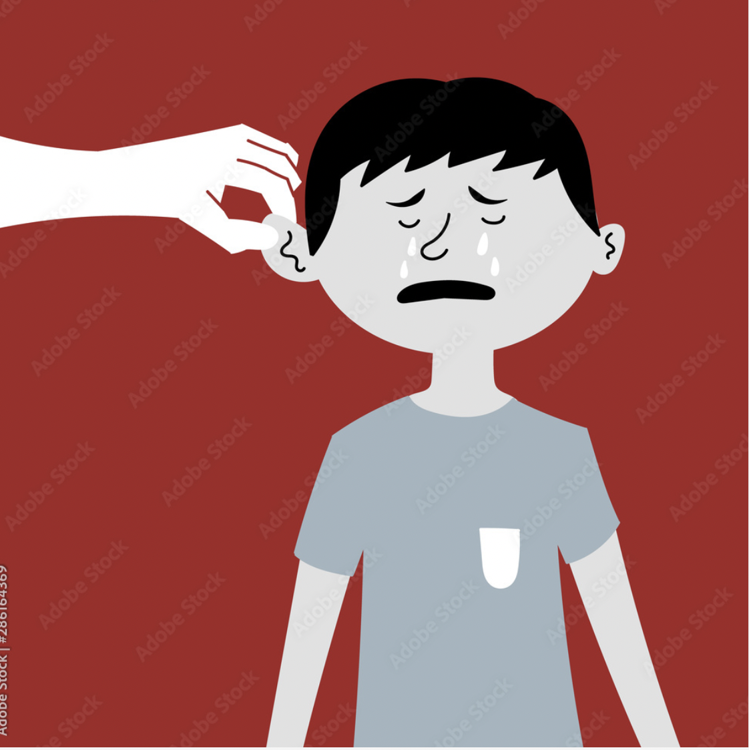

Slide 24
PIC OF TEACHER

Slide 25
The Law was God’s good law given for Israel for a given purpose so that it is able to get Israel to the Messianic time.

Slide 27
23 Now before faith came, we were held captive under the law, imprisoned until the coming faith would be revealed. 24 So then, the law was our guardian until Christ came, in order that we might be justified by faith.
Galatians 3:23–24
ESV

Slide 28
14 For the whole law is fulfilled in one word: “You shall love your neighbor as yourself.”
Galatians 5:14
ESV

Slide 29
25 But now that faith has come, we are no longer under a guardian, 26 for in Christ Jesus you are all sons of God, through faith.
Galatians 3:25–26
ESV

Slide 30
Big Idea: I live in the kingdom of God through love and righteousness.

Slide 31
Big Idea: I live in the kingdom of God through love and righteousness.

Slide 32
Practical Takeaways:
1. Jesus, the Messiah, fulfills the Law.
‌2. We are no longer slaves to the Law, rather we have freedom from the Law.
‌3. Life in the kingdom of God is lived through love and righteousness.

