Slide 1
How does the Book of Exodus look forward to Jesus the Messiah?

Slide 2
Big Idea: Jesus is at the center of it all.
Pastor Fel, Lizzy said “today is the best day of my life! I never got a golden egg before!!”
Thank you ❤️❤️❤️

Slide 3
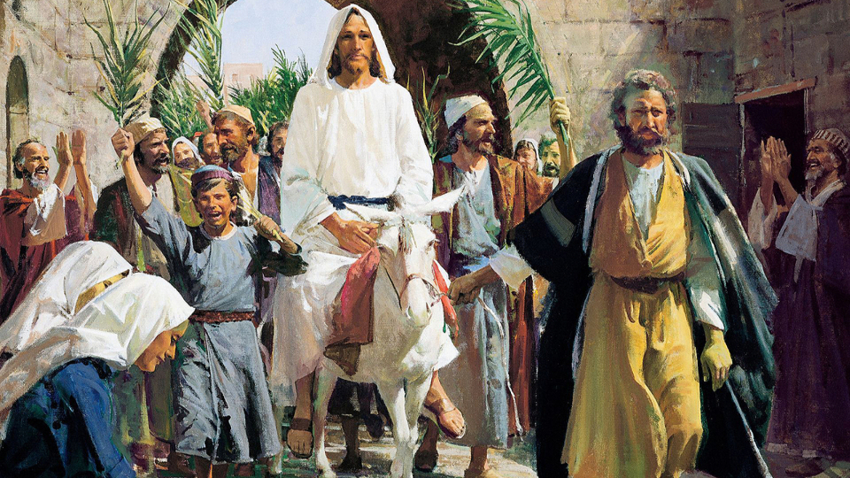

Slide 4
Big Idea: Jesus is at the center of it all.

Slide 5
45 I will dwell among the people of Israel and will be their God. 46 And they shall know that I am the Lord their God, who brought them out of the land of Egypt that I might dwell among them. I am the Lord their God.
Exodus 29:45–46
ESV

Slide 6
3 And I heard a loud voice from the throne saying, “Behold, the dwelling place of God is with man. He will dwell with them, and they will be his people, and God himself will be with them as their God.
Revelation 21:3
ESV

Slide 7
The Tabernacle and Priesthood

Slide 8
Priests serve as a bridge between Israel and God.

Slide 9
34 Then the cloud covered the tent of meeting, and the glory of the Lord filled the tabernacle. 35 And Moses was not able to enter the tent of meeting because the cloud settled on it, and the glory of the Lord filled the tabernacle. 36 Throughout all their journeys, whenever the cloud was taken up from over the tabernacle, the people of Israel would set out. 37 But if the cloud was not taken up, then they did not set out till the day that it was taken up. 38 For the cloud of the Lord was on the tabernacle by day, and fire was in it by night, in the sight of all the house of Israel throughout all their journeys.
Exodus 40:34–38
ESV

Slide 10
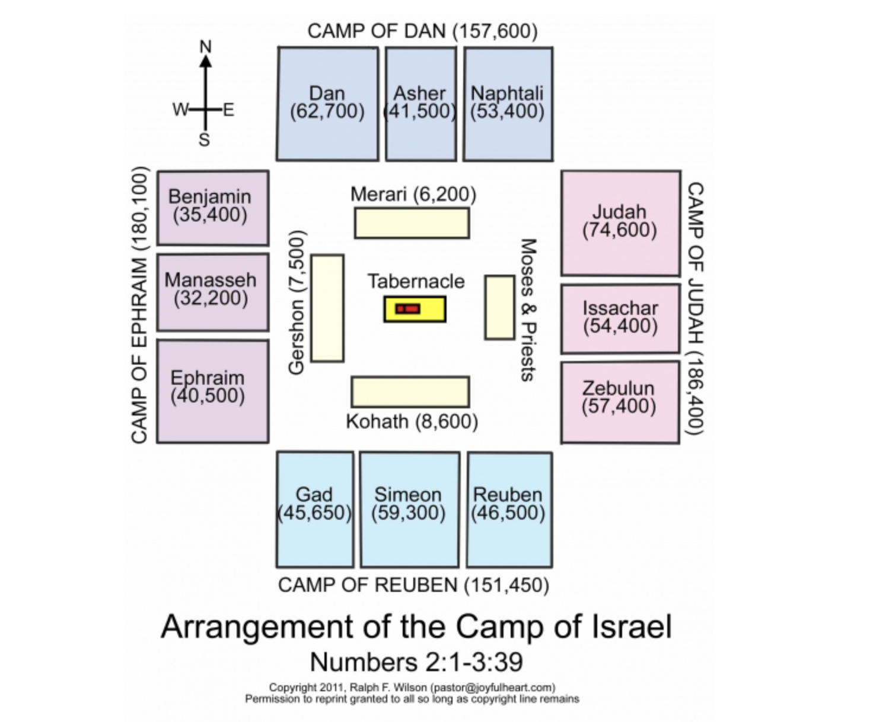
Pic of tabernacle

Slide 11
14 And the Word became flesh and dwelt among us, and we have seen his glory, glory as of the only Son from the Father, full of grace and truth.
John 1:14
ESV

Slide 12
The Manna from Heaven

Slide 13
48 I am the bread of life. 49 Your fathers ate the manna in the wilderness, and they died. 50 This is the bread that comes down from heaven, so that one may eat of it and not die. 51 I am the living bread that came down from heaven. If anyone eats of this bread, he will live forever. And the bread that I will give for the life of the world is my flesh.”
John 6:48–51
ESV

Slide 14
Moses as a Type of Christ

Slide 15
17 “Do not think that I have come to abolish the Law or the Prophets; I have not come to abolish them but to fulfill them.
Matthew 5:17
ESV

Slide 16
17 For the law was given through Moses; grace and truth came through Jesus Christ.
John 1:17
ESV

Slide 17
6 But as it is, Christ has obtained a ministry that is as much more excellent than the old as the covenant he mediates is better, since it is enacted on better promises. 7 For if that first covenant had been faultless, there would have been no occasion to look for a second. 8 For he finds fault with them when he says: “Behold, the days are coming, declares the Lord, when I will establish a new covenant with the house of Israel and with the house of Judah, 9 not like the covenant that I made with their fathers on the day when I took them by the hand to bring them out of the land of Egypt. For they did not continue in my covenant, and so I showed no concern for them, declares the Lord.
Hebrews 8:6–13
ESV

Slide 18
10 For this is the covenant that I will make with the house of Israel after those days, declares the Lord: I will put my laws into their minds, and write them on their hearts, and I will be their God, and they shall be my people. 11 And they shall not teach, each one his neighbor and each one his brother, saying, ‘Know the Lord,’ for they shall all know me, from the least of them to the greatest. 12 For I will be merciful toward their iniquities, and I will remember their sins no more.” 13 In speaking of a new covenant, he makes the first one obsolete. And what is becoming obsolete and growing old is ready to vanish away.
Hebrews 8:6–13
ESV

Slide 19
Passover Lamb

Slide 20
29 The next day he saw Jesus coming toward him, and said, “Behold, the Lamb of God, who takes away the sin of the world!
John 1:29
ESV

Slide 21
Deliverance and Redemption

Slide 22
7 Then the Lord said, “I have surely seen the affliction of my people who are in Egypt and have heard their cry because of their taskmasters. I know their sufferings, 8 and I have come down to deliver them out of the hand of the Egyptians and to bring them up out of that land to a good and broad land, a land flowing with milk and honey, to the place of the Canaanites, the Hittites, the Amorites, the Perizzites, the Hivites, and the Jebusites. 9 And now, behold, the cry of the people of Israel has come to me, and I have also seen the oppression with which the Egyptians oppress them.
Exodus 3:7–9
ESV

Slide 23
7 Cleanse out the old leaven that you may be a new lump, as you really are unleavened. For Christ, our Passover lamb, has been sacrificed.
1 Corinthians 5:7
ESV

Slide 24
15 “The Lord your God will raise up for you a prophet like me from among you, from your brothers—it is to him you shall listen— 16 just as you desired of the Lord your God at Horeb on the day of the assembly, when you said, ‘Let me not hear again the voice of the Lord my God or see this great fire any more, lest I die.’ 17 And the Lord said to me, ‘They are right in what they have spoken. 18 I will raise up for them a prophet like you from among their brothers. And I will put my words in his mouth, and he shall speak to them all that I command him.
Deuteronomy 18:15–18
ESV

Slide 25
1 Therefore, holy brothers, you who share in a heavenly calling, consider Jesus, the apostle and high priest of our confession, 2 who was faithful to him who appointed him, just as Moses also was faithful in all God’s house. 3 For Jesus has been counted worthy of more glory than Moses—as much more glory as the builder of a house has more honor than the house itself. 4 (For every house is built by someone, but the builder of all things is God.) 5 Now Moses was faithful in all God’s house as a servant, to testify to the things that were to be spoken later, 6 but Christ is faithful over God’s house as a son. And we are his house, if indeed we hold fast our confidence and our boasting in our hope.
Hebrews 3:1–6
ESV

Slide 26
Practical Takeaways: Jesus is:
‌1. The Great High Priest and God dwelling with man.
2. The Bread of Life.
‌3. Greater than Moses.
‌4. The Lamb of God.
‌5. The Ultimate Prophet, Mediator between God and man. He is the great deliverer.
‌

